Slide 1
Using Lighthouse
Test your Progressive Web App

Slide 2

Notes:
Lighthouse is a tool for testing progressive web apps.
It's available as a Chrome extension or as a Node package and can be integrated into a build process, for example if you're using gulp .

Slide 3
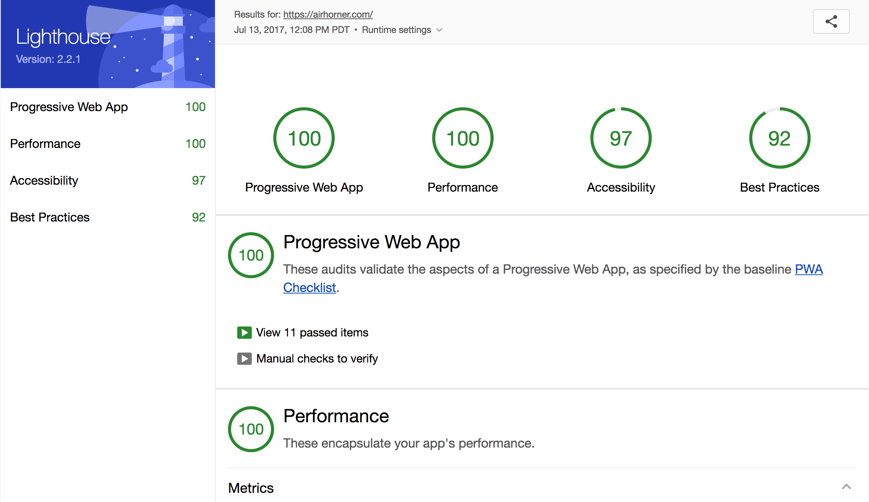
Notes:
This screenshot shows part of a Lighthouse report for the website pwa.rocks.
Lighthouse completes testing within a few seconds and presents its report as a web page. Lighthouse provides a total score and individual metrics grouped in four categories:
Progressive Web App: How well does your application meet the criteria to be considered a Progressive Web Application
Best practices: These are tests outside the Progressive Web Application space, for things like accessibility and whether your app uses the most up to date API's
Performance metrics: These tests measure your application’s overall performance
Fancier stuff: A list of newer features that you could be using in your app. This category of tests is only advisory, and doesn't affect your score.
Lighthouse integrates testing for patterns such as RAIL and performance measuring tools such as PageSpeed Insights — so you don’t have to set up a suite of tests on your own.

Slide 4
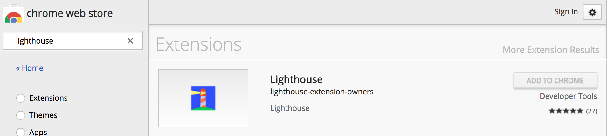
Chrome extension
Notes:
Chrome extension

Slide 5
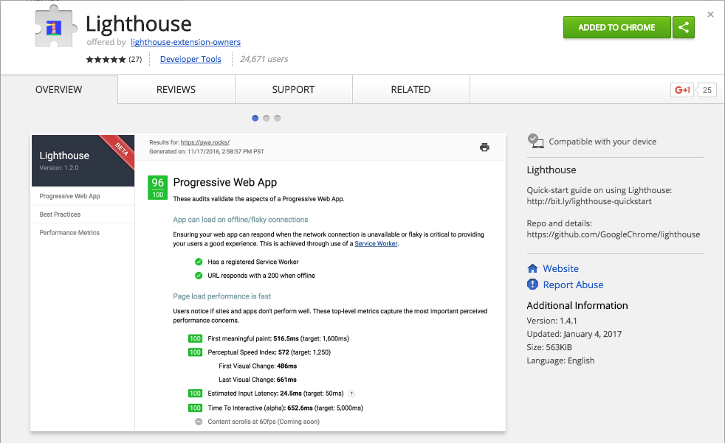
Notes:
Chrome extension

Slide 6
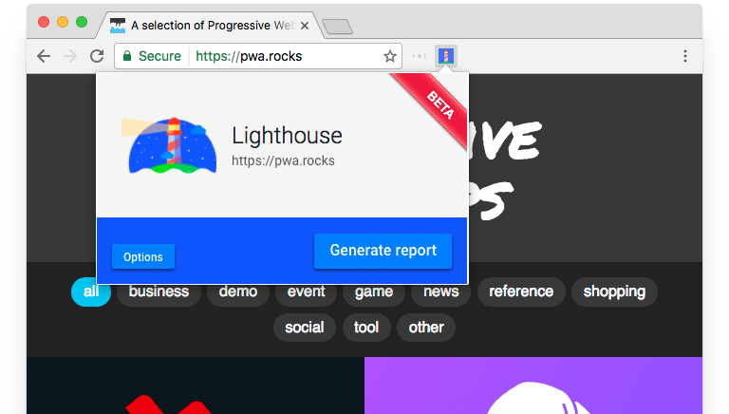
Running Lighthouse in the browser
Notes:
Once the extension is installed you can click the icon to produce the Lighthouse menu. There you can generate a report for the site.
Clicking Generate Report will begin the analysis.
Lighthouse uses Chrome’s debugging protocols to run its tests.

Slide 7
Using Lighthouse in the CLI
npm install -g lighthouse
lighthouse https://pwa.rocks
Notes:
To install the command line version of Lighthouse you must have Node.js installed on your computer.
The first command here installs lighthouse globally (-g) with npm (Node package manager).
The second command runs lighthouse on a PWA site, in this case https://pwa.rocks.

Slide 8
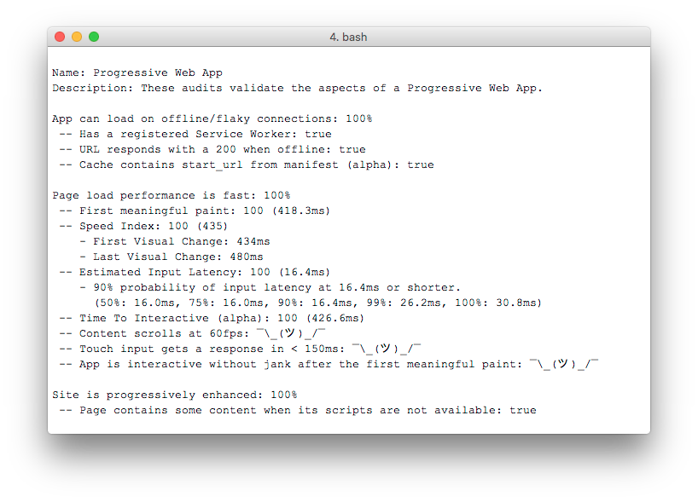
Notes:
The command line version of Lighthouse will produce output in the command line.
It will also produce an HTML version of the report which is identical to the report generated by the Chrome extension.

Slide 9
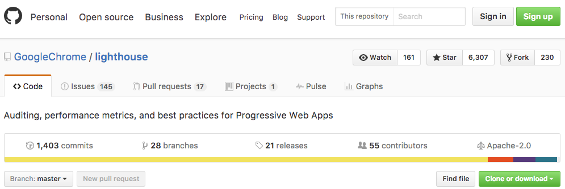
GitHub
Notes:
Lighthouse is an open source project with many contributors.
You can find it on GitHub at github.com/GoogleChrome/lighthouse.
Patches and additional tests are welcome — and the great thing is, it's extensible! You can fork the project and add your own tests.

Slide 10
Lab Overview
Install Lighthouse extension
Test an app
Make an app into a PWA
Use Lighthouse from the CLI

Slide 11
Resources
Lighthouse on GitHub
pwa.rocks: lots of PWAs to test!

